Slide 1

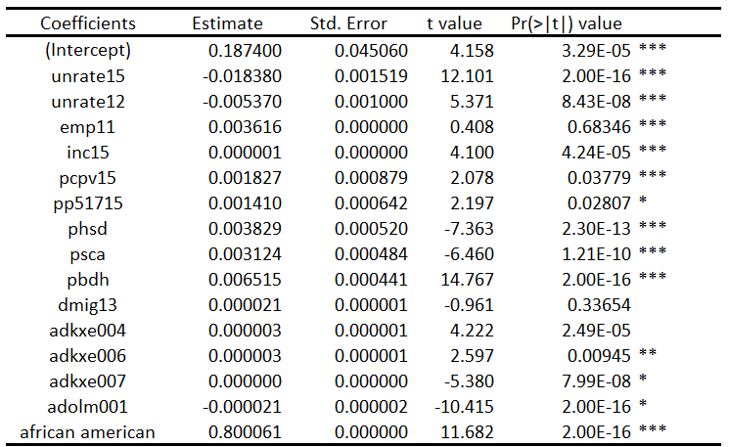
Stepwise Selection and Linear Regression
Unemployment Rate
Race (African American, American Indian, Asian, White)
Median Household Income
Poverty Estimators
Educational Attainments (Diploma, Bachelor, Masters, PhD.)
Migration Rates
For every percentage of increase in African American population, 0.8 percent of democratic votes should increase
For every percentage of decrease in unemployment rate, 0.02 percent of democratic should increase.
For educational attainment increase in the country, around 0.05 percent increase should be in democrat votes
R-Square: 0.6851
Adjusted R-Square: 0.7038

